Slide 1


CE-QUAl-W2 Calibration/Validation
UNCLASSIFIED
Barry Bunch, DE, PE and Zhonglong Zhang, PhD, PE, PH
U.S. Army Engineer Research and Development Center, Environmental Laboratory
CE-QUAL-W2 Workshop
August 16 - 18, 2022
Environmental Systems
Modeling Team
UNCLASSIFIED

Slide 2
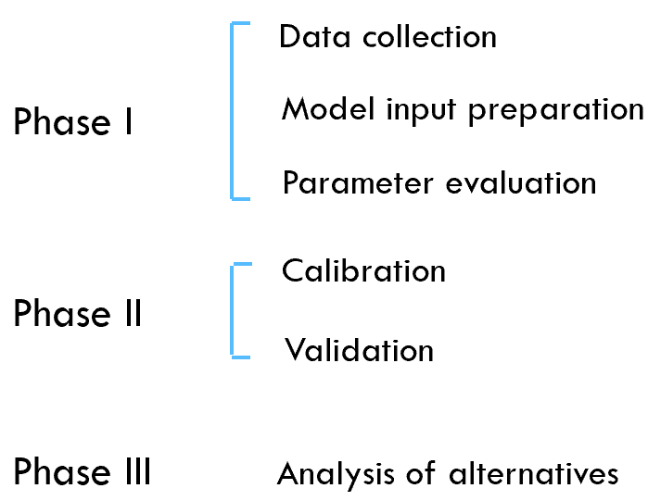
Water Quality Model Application Processes

Slide 3
Model Calibration
In EPA guidance, calibration is defined as the process of adjusting model parameters within physically defensible ranges until the resulting predictions give the best possible fit to the observed data (EPA 1994).
In some disciplines, calibration is also referred to as parameter estimation (Beck et al. 1994).
Calibration parameters are parameters whose values are uncertain.
Adjustments for calibration parameters should be constrained by physically sensible limits.
Calibration is an iterative process whereby model coefficients are adjusted until an adequate fit of observed versus predicted data is obtained.

Slide 4
Model Calibration
Model parameter/coefficient values are adjusted manually by trial and error. This requires the user to do multiple runs of the model.
Sufficient observed data must be collected to allow for an accurate calibration as well as analysis of different alternatives in the system.
The model cannot be expected to be more accurate than the errors (confidence intervals) in the input and observed data. You cannot calibrate the model to any greater accuracy than the inherent uncertainty associated with the data used to develop the model.

Slide 5
Calibration Process
Begin with literature values for model parameters
Adjust within acceptable ranges, until…
Model results “match” observed data
Start with hydrodynamics
Get temperature right
Assessed with water temperature profiles
Proceed to water quality
Inorganic suspended solids
Assess visually, as well as statistically
Graphical plots of model vs. data
Mean absolute error, percent bias, relative percent error

Slide 6
Calibration Performance Evaluation
Both graphical comparisons and statistical evaluation are used in model calibration and validation
Graphical comparisons
Time series plots of modeled results and observed data for state variables (e.g., nutrient concentrations) or fluxes (e.g., flow x concentration)
Modeled and observed scatter plots, with 45º linear regression line displayed, for state variables or fluxes

Slide 7
Calibration Performance Evaluation
Performance statistics:
Error statistics, e.g., mean error (ME), absolute mean error (AME), relative bias (PBIAS), standard error of estimate, etc.
Correlation tests, e.g., Coefficient of determination (R²), Nash-Sutcliffe efficiency (NSE), etc.
There is no single accepted performance statistic or standard that determines whether a model is valid.

Slide 8
Performance Error Statistics
Mean Absolute Error (MAE)
Mean Error (ME)
Root Mean Square Error (RMSE)
Nash-Sutcliffe efficiency (NSE)
Percent bias (PBIAS)
Coefficient of determination R²

Slide 9
Calibration Data
Flow and water level data
Outflow temperature and water quality data
In-reservoir or river temperature and water quality data
Temperature profiles
Dissolved Oxygen and Nutrient profiles
Time Series
Algae data
Algal speciation
Functional groups
Secchi disk depth

Slide 10
Calibration Data

Slide 11
Calibration Data

Slide 12
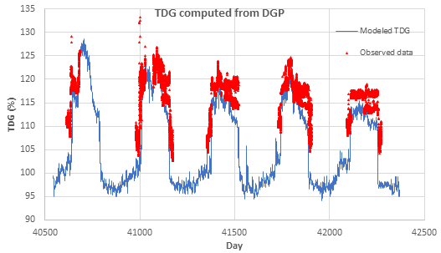
Calibration Data

Slide 13
Calibration Data

Slide 14
Hydrodynamics/Water Temperature Calibration Parameters
longitudinal eddy viscosity (Ax)
vertical eddy viscosity (Az)
bottom friction
sediment heat exchange
wind-sheltering coefficient
interaction with density field - SS, TDS, etc.
bathymetry of the model

Slide 15
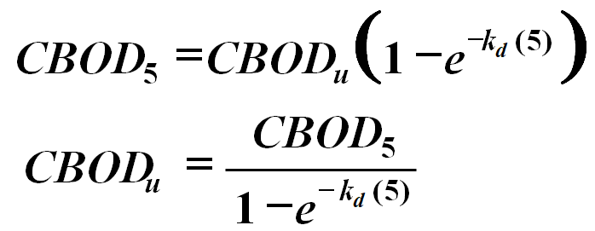
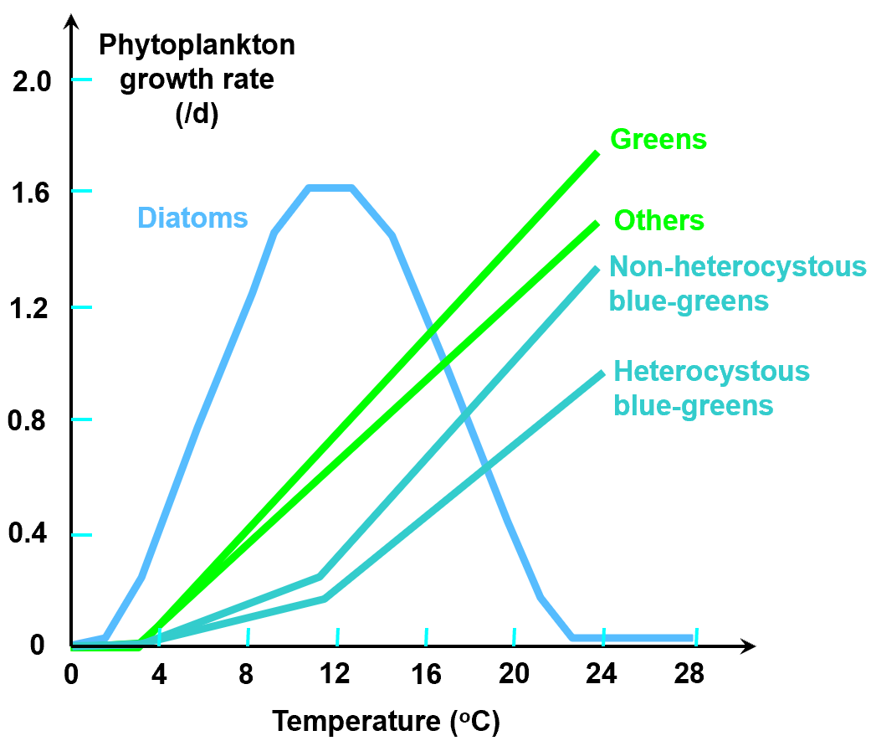
Water Quality Calibration Parameters
For water quality simulations, calibration parameters are varied widely, , it is preferable to obtain actual measurements of water quality coefficients such as CBOD decay rates…
Phytoplankton
Dissolved oxygen
Zooplankton
Inorganic N and P
Courtesy of Dr. Chapra

Slide 16
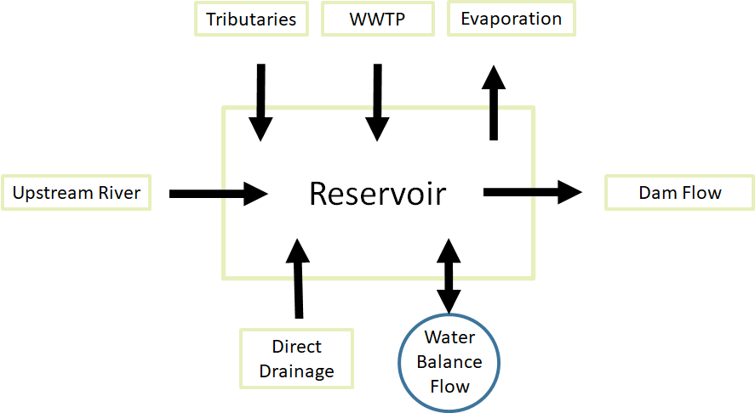
Fluid, Mass and Energy Balance
Have you accounted for all water?

Slide 17
Water Quality Model Calibration Suggestions
Make sure model output is appropriate.
Averaged vs instantaneous
Only tweak appropriate model input parameters/coefficients.
Physically relevant
Begin with literature values for model parameters.
Start with water temperature and proceed to other water quality constituents.
All reactions are temperature dependent

Slide 18
Water Quality Model Calibration Suggestions (cont.)
Do not force a calibration to fit with unrealistic water quality parameter’s values
Use sensitivity analysis to investigate relations between observations, parameters, and model predictions

Slide 19
W2 Model Stability
The W2 model works with dynamic time steps. Auto-time-stepping does not guarantee numerical stability.
Defining the time steps for calculations is a key factor.
Large time steps lead to stability violation and very small time-steps increase the computation time.
To have the stability, the spatial and temporal steps (Δx and Δt) should be fine enough.
The timestep adjustment is based on the characteristics of the waterbody and boundary conditions.

Slide 20
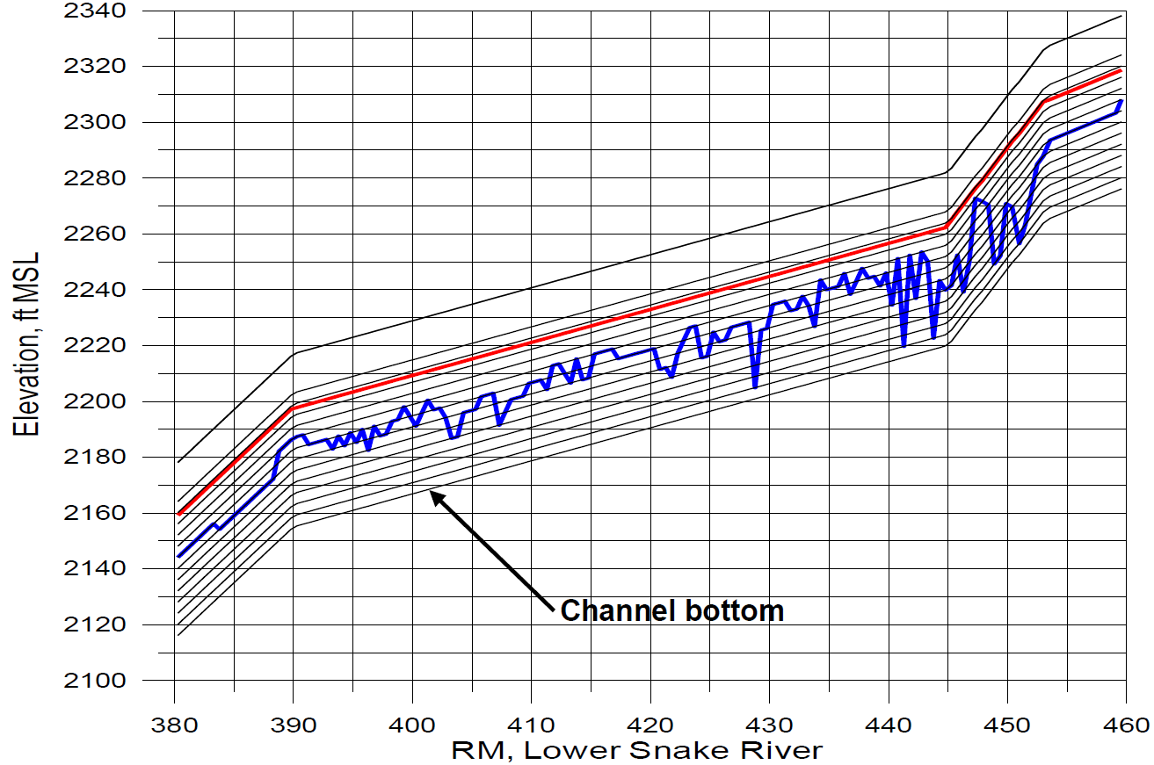
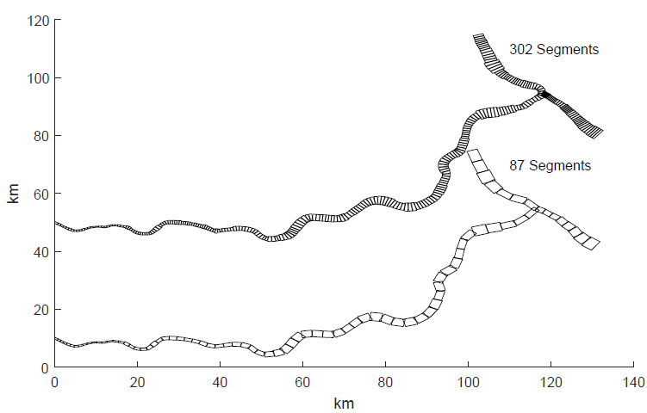
W2 Model Stability
The minimum timestep is useful during periods of extremely high flows.
UPWIND, QUICKEST, or ULTIMATE with the latter being the recommended option.
W2 grid resolution affects the model’s stability

Slide 21

Questions?

